Slide 1
Course - DT228/1
Information Technology Fundamentals
TECHNOLOGY FOR PROBLEM-SOLVING

Slide 2
What Sort of Problems?
Information-oriented problems where information technology (including information systems) provide the solution.
In government, business and education. Examples:
Government department databases
Manufacturing technology and computer systems for retail
Student databases, e-Learning systems (such as Webcourses)

Slide 3
Solving Problems
Developing and installing information systems solves many of the systemic information ‘problems’ in society.
Why?
Information technology and systems support the main functions of organisations.

Slide 4
Systems as Solutions: How?
Systems analysis, systems design, project management, implementation…
Having the RIGHT:
hardware systems,
networks,
software systems,
databases,
supports and facilities.

Slide 5
Hardware for Systems
Hardware acquisition – when hardware is evaluated against the following factors:
Performance
Speed, capacity, throughput
Cost
Lease or purchase price
Cost of operations and maintenance
.../ continued

Slide 6
Hardware for Systems (2)
Reliability
Any risk of malfunction and maintenance requirements will be identified
Error control and diagnostic features will be specified
Compatibility
With existing hardware and software?
With hardware and software provided by alternative vendors?
.../ continued

Slide 7
Hardware for Systems (3)
‘Future proof’?
What is the speculated product life cycle?
Does it use a new, untested technology?
Does it run the risk of obsolescence?
Ergonomics - is the equipment ‘human factor engineered?’ EG:
Is the hardware user-friendly?
Is the hardware safe, comfortable and easy to use?

Slide 8
Software for Systems
Software acquisition - to get the most appropriate software for a particular task for the best possible price.
Getting the software may follow planning, budgeting, requirements specification, and negotiating contracts of procurement.
Then comes the tasks of monitoring development progress and evaluating of the software acquired.

Slide 9
Software for Systems (2)
Software acquisition considerations might be, for example:
Purpose (of the software)
Planning (to place and use the software)
Cost-benefit analysis
Quality
Licensing
Life span (or life cycle)
Risks

Slide 10
Types of Software
Generic (Off-The-Shelf) applications
Well known packages such as word processors, accounting, image editing … to name but a few.
Anyone is able to buy them.
Bespoke (customised) software products
Systems that are built specifically for individual people/organisations.
They can also be generic software packages that are customised.
The high-cost nature of this type of software means it is not economically available to all.

Slide 11
Types of Software (2)
Systems software
This type of software exists at the operating system layer. It actually includes the operating system itself, compilers, editors… any kind of software that supports the execution and/or development of applications.
Application software
Real-time software
Programs that monitor/analyse/control real world events. A nuclear power plant cooling system is a good example.

Slide 12
Types of Software (3)
More application software
Business Software
Business Information Systems such as payroll, accounts and order management/tracking. There are off-the-shelf packages available for small businesses, however large businesses usually develop their own software.
Engineering and Scientific Software
Typically ‘number crunching’ programs for areas such as astronomy, molecular biology, weather forecasting and Computer Aided Design (CAD) for engineers. Generic programs do exist for some of these areas, however research usually requires new software to be developed.

Slide 13
Types of Software (4)
Even more application software
Embedded Software
Intelligent products such as cookers, washing machines and microwaves use embedded software that typically resides in a Read Only Memory (ROM). Due to the individual nature of such products this software is usually developed/tailored for each.
Personal Computer Software
Spreadsheets, word processors, computer graphics, multimedia and database applications are typical. This type of software is predominantly off-the-shelf but it goes through many versions to remove bugs and increase functionality.

Slide 14
Types of Software (5)
Last example - application software
Artificial Intelligence (AI) software
AI is used to solve complex problems such as scheduling the maintenance of manufacturing equipment to minimise their shutdown. Other uses include pattern recognition (speech/visual). Typically this software is developed for each application specifically.
The application of computers, through software development, is only limited by our imaginations...(and its cost).

Slide 15
Programming
Programming is the art of giving instructions to computers.
Producing a working program requires several stages:
Analysis
Design
Coding (Programming)
Verification and Testing
Maintenance

Slide 16
Coding
Coding is the actual writing of the code and consists of repeatedly:
Writing code
Compiling the code
Testing the code
until finally the programmer is satisfied that the code has been successfully implemented.

Slide 17
Coding (2)
The most important tools of a programmer are:
a good editor
a good compiler
a good debugger
Often the three of these are combined as one tool known as an IDE - an Integrated Development Environment, such as Code::blocks or Eclipse.

Slide 18
Coding (3)
Coding can be seen as simply interpreting the design documents into machine executable instructions.
There are many different programming languages
Factors including the application’s domain will help in making a choice of which programming language to use:
Platform (Hardware, Operating System, Network),
Programming Paradigm (Object-Oriented/function-based/event-based)
The experience of the ‘programmers’ that are available to do the coding.

Slide 19
Coding (4)
As mentioned previously, coding is interpreting a design into a set of instructions for the computer to execute.
There are many languages that can be used to code a program:
(Abstractly) High-Level Languages
Java, C, C++, Pascal
Low –Level Languages
Assember, Machine Code

Slide 20
Procedural Language
Procedural language is a type of computer programming language that specifies a series of well-structured steps and procedures within its programming context to compose a program. It contains a systematic order of statements, functions and commands to complete a computational task or program.
Procedural language is also known as imperative language.

Slide 21
C is a Procedural Language
C was designed for efficiency, so that the compiler could produce the most efficient code, and the programmer the could spend the least time typing.
Developed from 1969 at the Bell Telephone Laboratory by Dennis Richie.
Initially, C was designed for the compilation of operating systems.
It is a fairly simple language to learn, compared to others.

Slide 22
C Example
//C Hello World example
#include <stdio.h>
int main()
{ printf("Hello world\n");
return 0;
}

Slide 23
OOPS (Object Oriented Programming System)
In a procedural language a number is just a number.
In real life it may make sense to multiply two numbers - 6 metres long by 3 metres will give us an area of 18 square metres.
In other cases it may not - 6 metres long by 3 ‘something elses’ ?
In OOPS we can impose rules on what can be done to particular variables.

Slide 24
OOPS (2)
With OOPS we model real-world things as objects. For instance, we may describe a car as an object.
The car ‘object’ has ‘attributes’ such as make, model, year of manufacture, etcetera,
and it has methods. We may drive the car, we may fill it with petrol, we can record how far it has travelled.

Slide 25
OOPS (3)
Object orientation makes it easier to reuse code. The code written to describe a car is independent of the rest of the program, and so it can easily be extracted from the program and reused in another program.
The code used to describe a general car is known as a class. A particular car is an instance of that class.

Slide 26
C++
C had its features extended to include Object Orientated capabilities to become C++.
It was developed by Bjarne Stroustrup.
C ++ has heavily influenced the design of some newer languages such as C# and Java.
C++ is a complex language.

Slide 27
C++ Example
#include <iostream> using namespace std; void main() { cout << "Hello World!" << endl;
cout << "Welcome to C++ Programming" << endl; }

Slide 28
Database Programming
A very common implementation of a database is a Relational Database Management System (RDBMS). To users, the information in a database can be accessed by using Structured Query Language (SQL) a database language common to most databases. However, SQL only provides commands to access and manipulate the data in the database.

Slide 29
Database Programming (2)
Programming often needs to use coded conditions, branching and loops.
None of these are a part of the SQL language, so many common programming languages allow integration with SQL through a common library such as Open Data Base Connectivity (ODBC), Object Linking and Embedding (OLE) and sometimes with application programming interfaces or libraries supplied with the database.

Slide 30
SQL Example
A simple SELECT statement looks something like this;
SELECT column_name,column_name FROM table_name;

Slide 31
Embeddded (in C) SQL Example
/* Begin program */
EXEC SQL INCLUDE SQLCA;
EXEC SQL BEGIN DECLARE SECTION
host_name character_string(20)
host_emp_number integer
EXEC SQL END DECLARE SECTION
EXEC SQL WHENEVER SQLERROR STOP
EXEC SQL CONNECT frans
/* Formulate query, something like: */
EXEC SQL SELECT name emp_number
INTO host_name host_emp_number
FROM employees
WHERE emp_number = 10001
/* Print host_name and host_emp_number */
EXEC SQL DISCONNECT
/* End program */

Slide 32

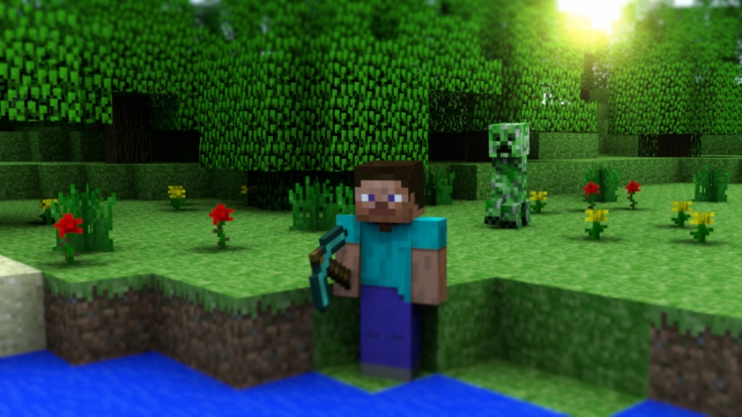
Problem – Game Graphics
The problem is that you need game environment and graphics for a game like Minecraft.

Slide 33
Solution – Game Graphics
Buy the Minecraft game as a software application or develop it as a programmer.
Use Java programming techniques with an API (Application Programming Interface).
Eclipse platform?
(Eclipse is an integrated development environment (IDE) that will allow you to use ‘plug-in’ code modules for graphics features.)

Slide 34
Problem – Business Information System
The problem is that you need a complex information system for an international business.
You need separate systems for:
Management
Administration
Manufacturing
Logistics

Slide 35
Solution – Business Information System
Management and Administration – buy or develop an Executive Information System (EIS), a Decision Support System (DSS) and a database with admin front end.
Example – place a graphics-oriented EIS ‘on top of’ a Local Area Network to gather all the business’ important data.
Develop a DSS for forecasting management decisions. (I would use C++ or Java.)

Slide 36
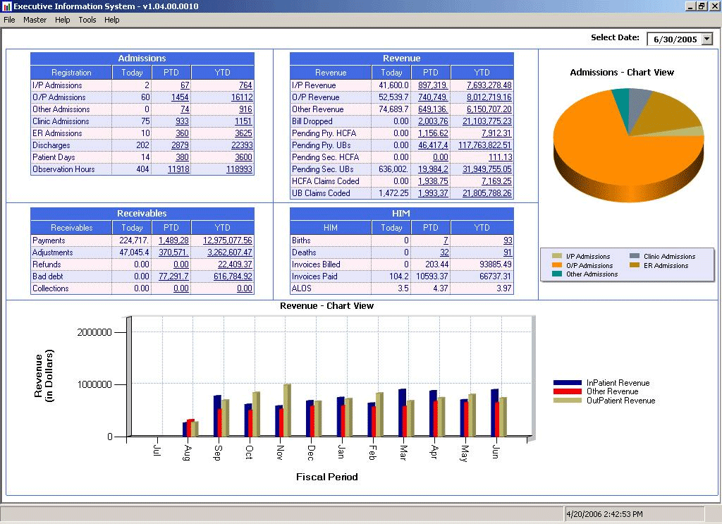
Executive Information System

Slide 37
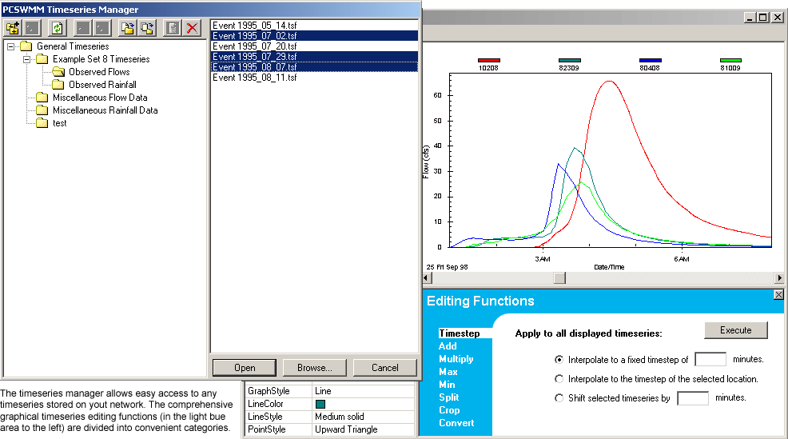
Decision Support System

Slide 38
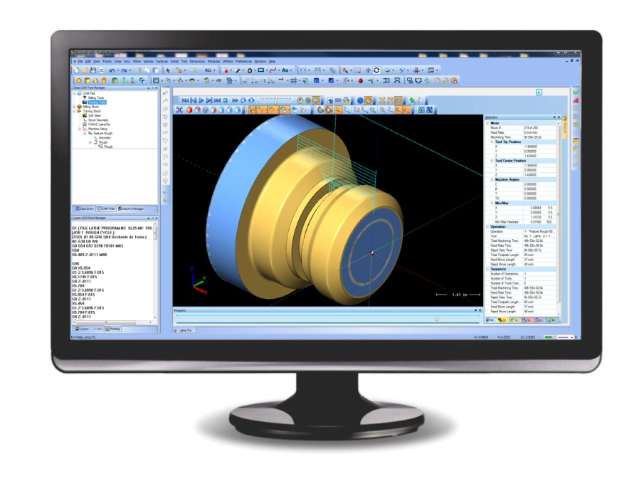
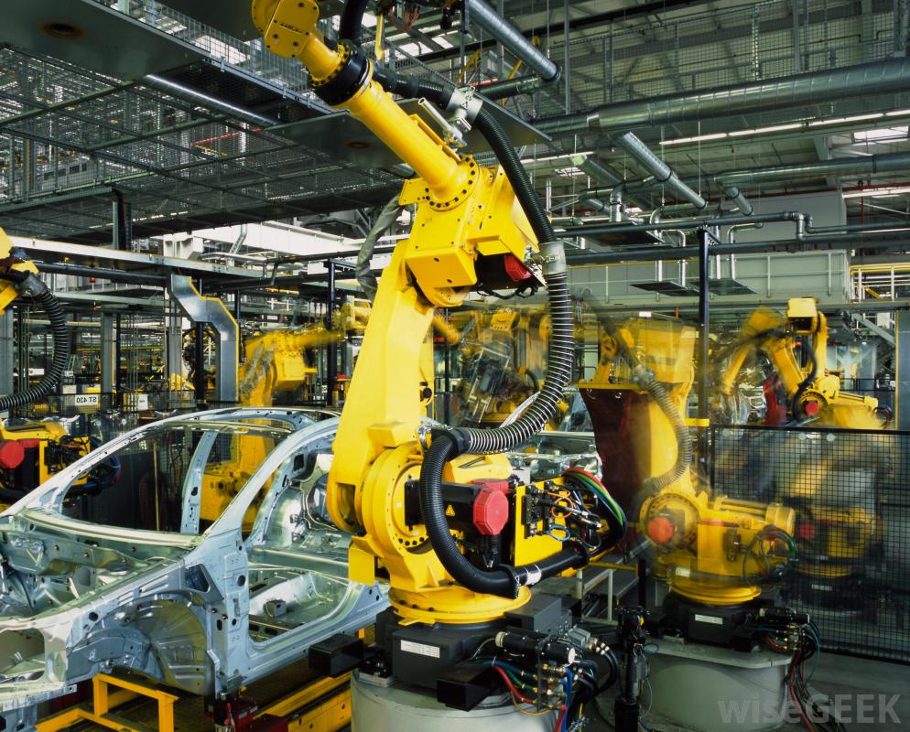
Solution – Business Information System (2)
CAD CAM for manufacturing.
(CAD – Computer Aided Design, CAM – Computer Aided Manufacturing).
CAD – Graphics applications for design
CAM – Machine operating software for CNC machining (Computer Numerical Control for controlling machine tools.)

Slide 39
Problem – Scientific System
The problem is that you need a complex scientific information system.
Example: Pharmacology – the study of drugs and concerned with the sciences of chemistry, biology (and physics in some instances – and botany).
The information system might record and compare experimental data. Consider a collection of databases...

Slide 40
Solution – Scientific System
Information technology and information systems for pharmacology.
A collection of databases with ‘interactivity applications’ – the ability to cross-reference disparate data and to simulate physical experiments.
EG chemical compound molecular structures in combination with biological cells as a graphic simulation.

Slide 41
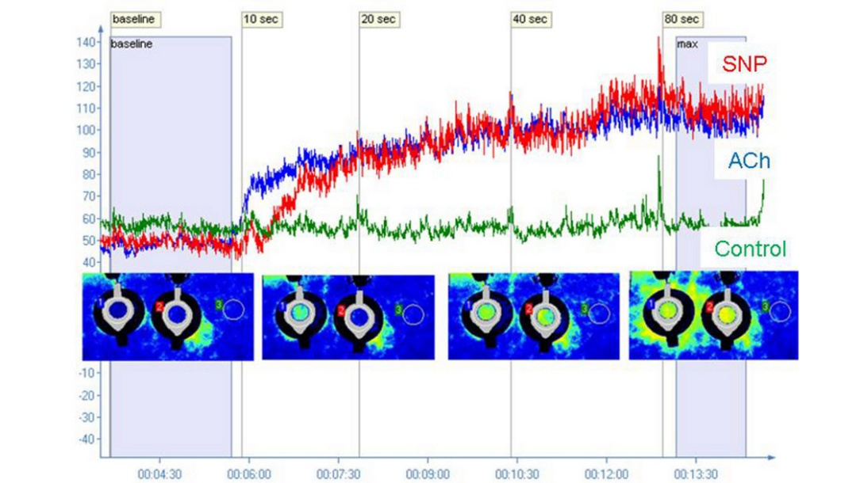
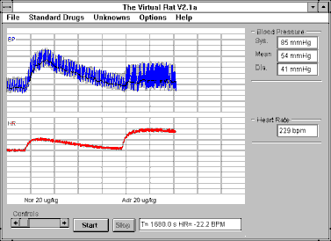
Pharmacology Systems
Iontophoresis using Perilont Micro Pharmacology system
The Virtual Rat is a simulation of the pithed rat experimental preparation for investigating the actions of drugs on the heart and cardiovascular system. "Pithing" refers to the destruction of spinal cord pathways, severing all the nerve connections between the brain and the cardiovascular system, simplify the interpretation of experimental results by removing the central baroreceptor reflexes.

Slide 42
Up Next
Next week’s lecture title is:
New Systems

